Slide 1

Capstone Project
Market Analysis in Banking Domain

Slide 2

Business Objectives
Basic Exploratory Analysis on different metrics available to get insights on term deposit
To analysis the various factors to convince the
customers to invest in a bank’s term deposit scheme .
Technology-wise Objective : Creating an End-to-End Pipeline to enhance the automation to do quick analysis and manage all the repetitive actions in a proper-structured manner.

Slide 3
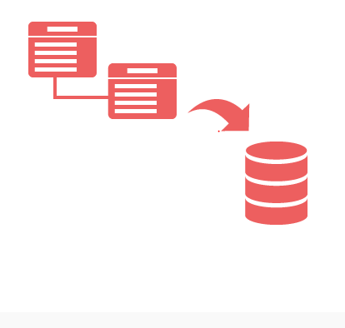
Data Description
There are OneTable(Records) :-
1. market_analysis

Slide 4

Data Description
Table:Dataset.csv
age INT Not Null,
job STRING Not Null,
marital STRING Not Null,
education STRING Not Null,
default STRING Not Null,
balance DOUBLE Not Null,
housing STRING Not Null,
loan STRING Not Null,
contact STRING Not Null,
day STRING Not Null,
month STRING Not Null,
duration bigint Not Null,
campaign INT Not Null,
pdays INT Not Null,
previous INT, Not Null
poutcome STRING Not Null,
y String Not Null

Slide 5









Technology Stack
Linux Commands (to run the bash script)
PostgreSQL(to create database - RDBMS)
Sqoop (Transfer data from PostgrSQL Server to HDFS/Hive)
HDFS (to store the data)
Hive (to create database)
SparkSQL & PySpark (to perform the EDA)
git (for version control)

Slide 6
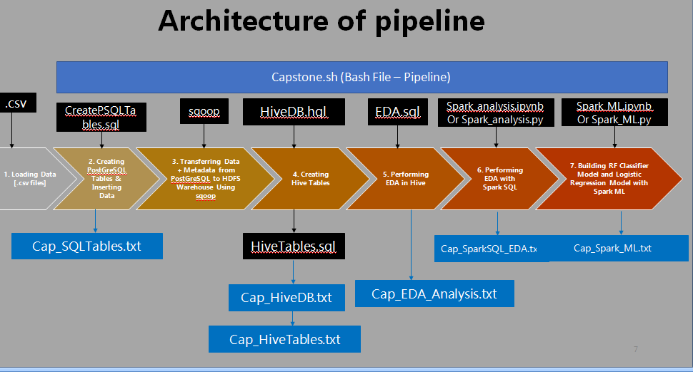

Slide 7

Challenges Faced
Importing the Data from Linux to Hive
Fetching the Hive tables in Spark (Jupyter Notebook Environment)

Slide 8

Inference
Modifying / Upgrading of Bank Term Deposit Scheme.
Fixing the Issues related to Scheme. so that probability increase the subscription.
Using the current model further analysis can be done with newly updated customer subscription to understand customer sentiments.

Slide 9
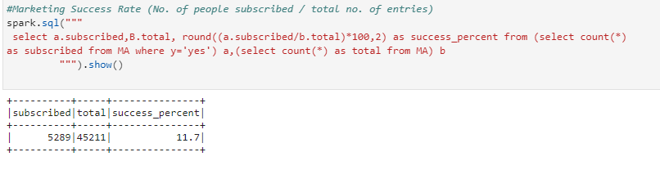
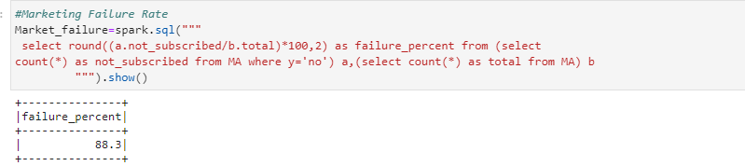
Market Success Rate
Market Failure Rate

Slide 10
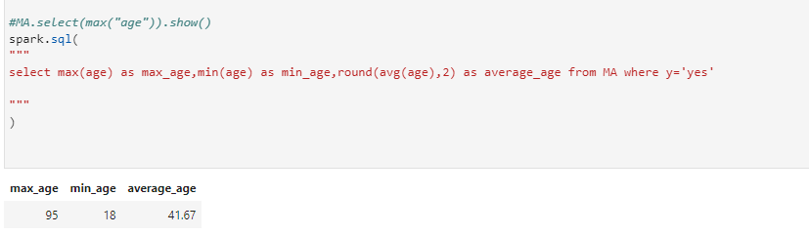
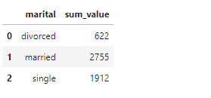
Maximun and Minimum Age for Subscription
Marital Status Wise Subscription
Married customer is more interested in Bank Term deposit Scheme

